Slide 2
Customer scenario
"Our security team is asking for help ensuring proper reviews are being done to code being added into our repositories. We have hundreds of repositories in our organization. What is the best way we can achieve at scale? We are new to some of the out-of-the-box settings and the GitHub API. Can you please help us create a solution that will accomplish this for our security team?"

Slide 3
SOLUTION
CODE REVIEW
Code review is the most commonly used procedure for validating the design and implementation of features. It helps developers to maintain consistency between design and implementation “styles” across many team members and between various projects on which the company is working.
“Code review is systematic examination … of computer source code. It is intended to find and fix mistakes overlooked in the initial development phase, improving both the overall quality of software and the developers’ skills.”

Slide 4
We CAN perform code review in two levels.
peer review
we expect developers to talk to each other about their design intentions and get feedback throughout the (usually non-linear) design/implementation process.
we don’t put limitations on what comments a reviewer might make about the reviewed code.
external review.
An external review addresses different issues than peer reviews. Specifically, external reviews focus on how to increase code quality, promote best practices, and remove “code smells.”
This level of review will look at the quality of the code itself, its potential effects on other areas of the project, and its adherence with company coding guidelines.

Slide 5
PEER REVIEW
pros
cons
Readability and Maintenance
Consistency
Performance
Exception Handling
Test Cases
Manual work
Lot of time consuming
Wont work for less team more work

Slide 6
external review
PROS
CONS
Readability and Maintenance
Coding Style
Code Smells
If external reviewer don’t have the knowledge about the logics
If delay in response

Slide 7
SOLUTION AS A BEST PRACTICE
As we discussed we have pros and cons in both the type what makes us the best practice is to choose the methods based on the situation applied to the team and the project
Scenario :
If it’s a small project inside the Organization and all team members are working to develop the software peer code review will help it with any one of code review tool available in the Github API .
Scenario :
If it’s a small or big project inside the Organization and all team members are working to develop the software and lead or someone is available to do the code revie external review will help it with code review tool available in the Github API .

Slide 8
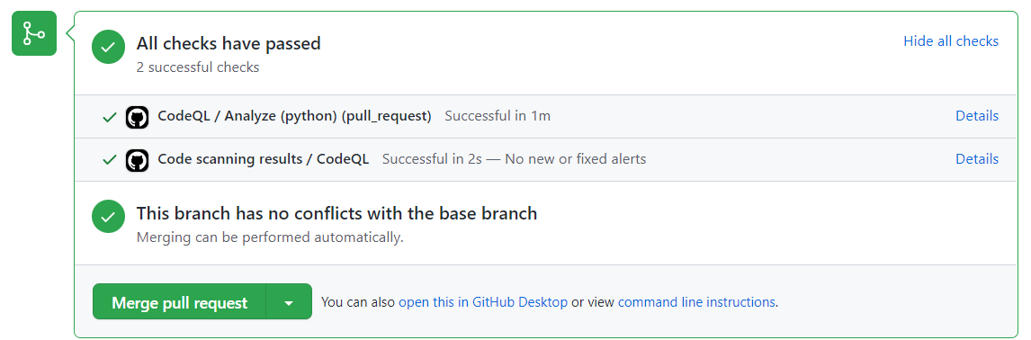
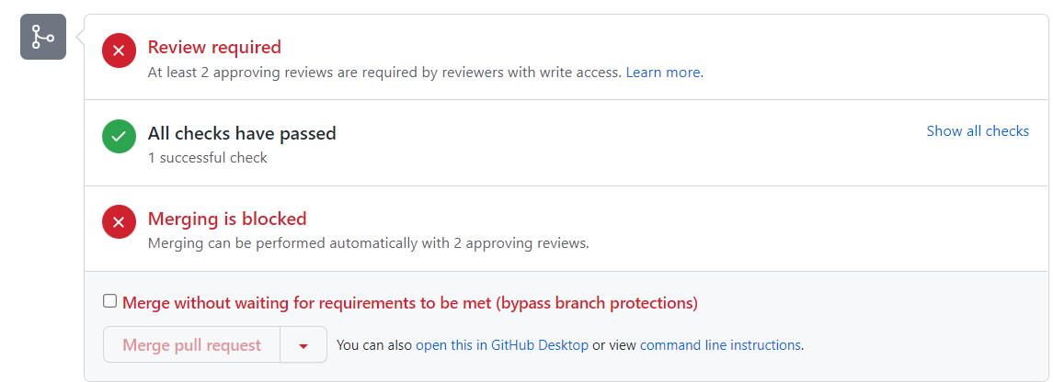
Below picture sows who are all contributing for this project can run the code review and merge it
Its indicated peer reviewing you can add required review block also with team members .
Below picture shown us about how we can add the external reviewer to the repo to do check the code and merge to the main branch .

Slide 9
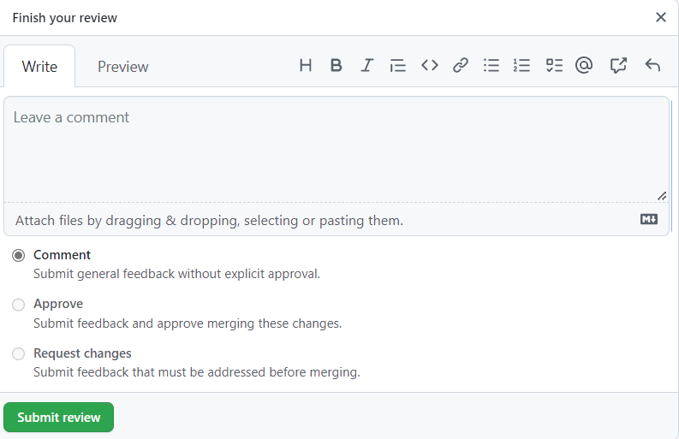
This is how reviewer will approve review or reject it

Slide 10
Another way is to based on the situation you can combine both ways make it more effective ways
Scenario :
If the project is having the high demand of peer review with the external review . Where you can mention peers and external review also a code review where all the team members including the external can review the code before merge and also it may take quite bit log time . Because all people should review if anyone not reviewed merge will delay until all the approve .
Note : you can make use of email notification option which can send a mail for each push events are triggered.

Slide 11
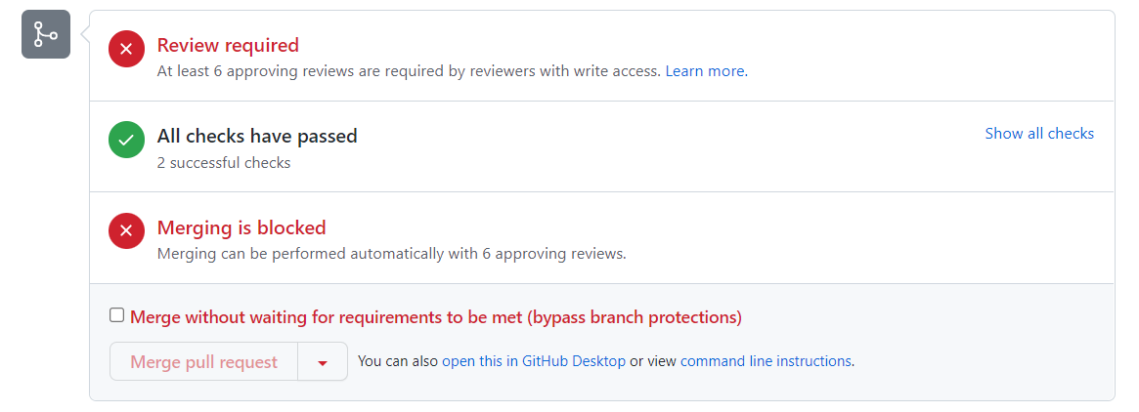
Image is same as external review image but notice the review block its increase to large number where team members and also external reviewer also authorized to review the work

Slide 12
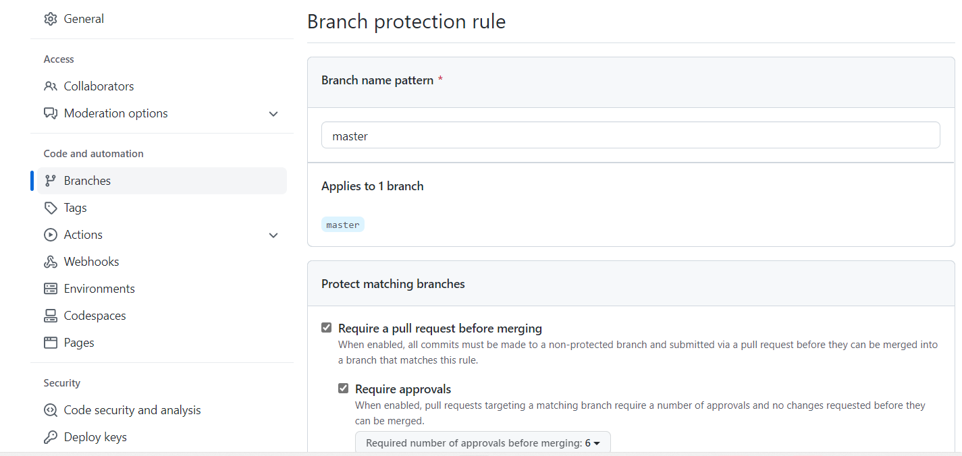
MAIN BRANCH PROTECTION
Our main Aim is to protect the main branch before merging it with any other branch . So we can add Branch rule it example :

Slide 13
CODE REVIEW TOOLS AVAILABLE IN GITHUB API
There are 50+ tools are available in Github to do the code review to achieve the code quality and code management .
We are attaching some of as a picture but as an example we are using CodeQL Analysis to review our code .
We can use another tools also like Sonar qube , ESLint , Pyre…..ext

Slide 14
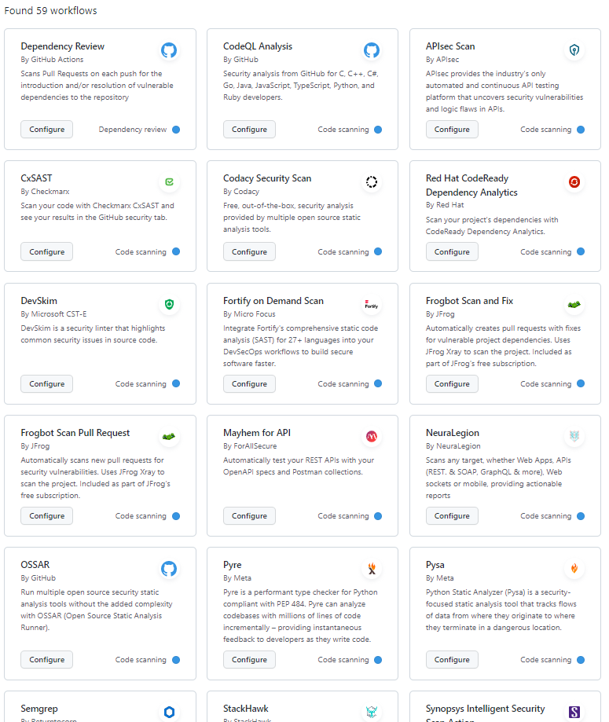

Slide 15

THANK YOU

